Slide 1
Progress of Week1, August
OUTLINE
How to Formulate Demand Charge
1.1 Two ways mentioned earlier
1.2 Add extra penalty – Take RBC as a base
1.3 Relate paper
（supplement Visualization of tou_cost）
1.4 “Hyper-param”-dc_price
（1.5 Reformulate by considering increment only）
1.5 Reformulate by introducing intermediate variables
2. Sensitive Tests

Slide 2
1. How to Formulate Demand Charge
-1.1. Two ways mentioned earlier
Demand charge horizon
Way 1: Always consider the max p_grid
P_grid
Way 2: Only consider the increment of max p_grid
P_grid
MPC prediction horizon
（P.S. Shadow area means dc, overlap means repeatedly dc）

Slide 3
1. How to Formulate Demand Charge
-1.1. Two ways mentioned earlier
Demand charge horizon
Way 1: Always consider the max p_grid
Current codes
P_grid
Way 2: Only consider the increment of max p_grid
Related to add (if … else …) into gurobi constraints, which is seemingly unsupported
P_grid
MPC prediction horizon
（P.S. Shadow area means dc, overlap means repeatedly dc）

Slide 4
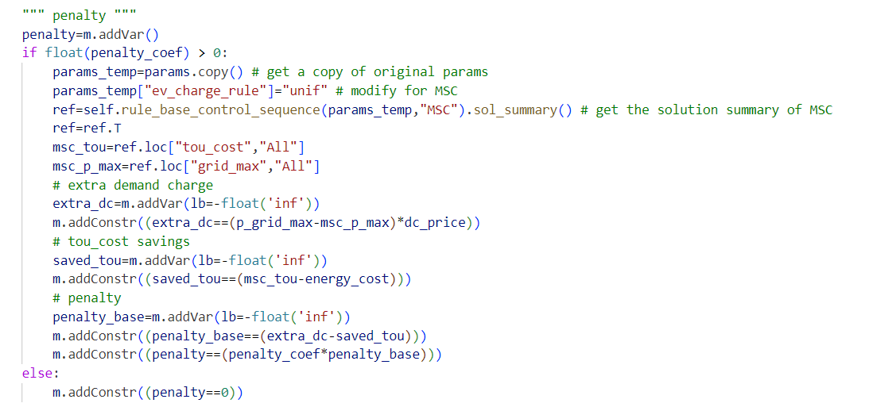
1. How to Formulate Demand Charge
-1.2 Add extra penalty – Take RBC as a base
0. Get tou_cost and p_grid_max of RBC_MSC as references
Calculate extra demand charge of MPC as extra_dc
Calculate tou_cost savings of MPC as saved_tou
Get penalty of penalty_coef * (extra_dc – saved_tou)

Slide 5


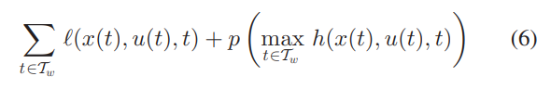
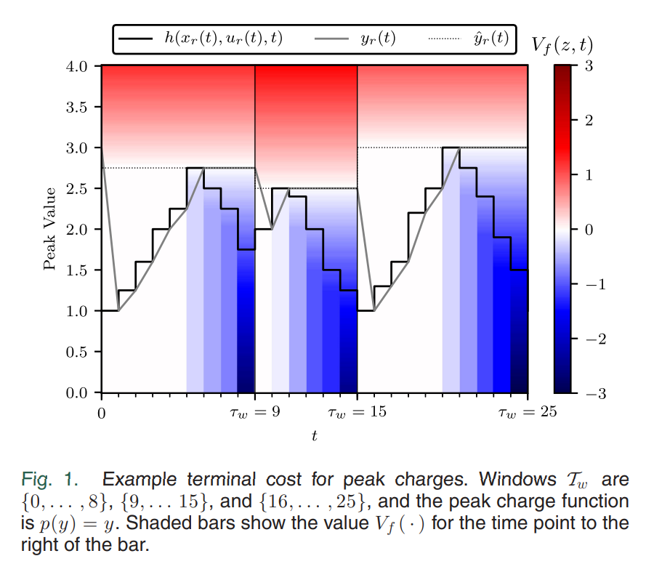
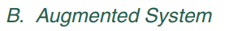
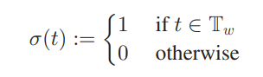
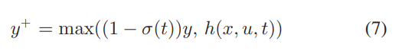
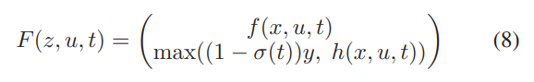
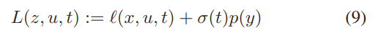
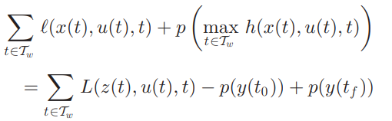
1. How to Formulate Demand Charge
-1.3 Relate paper

Slide 6
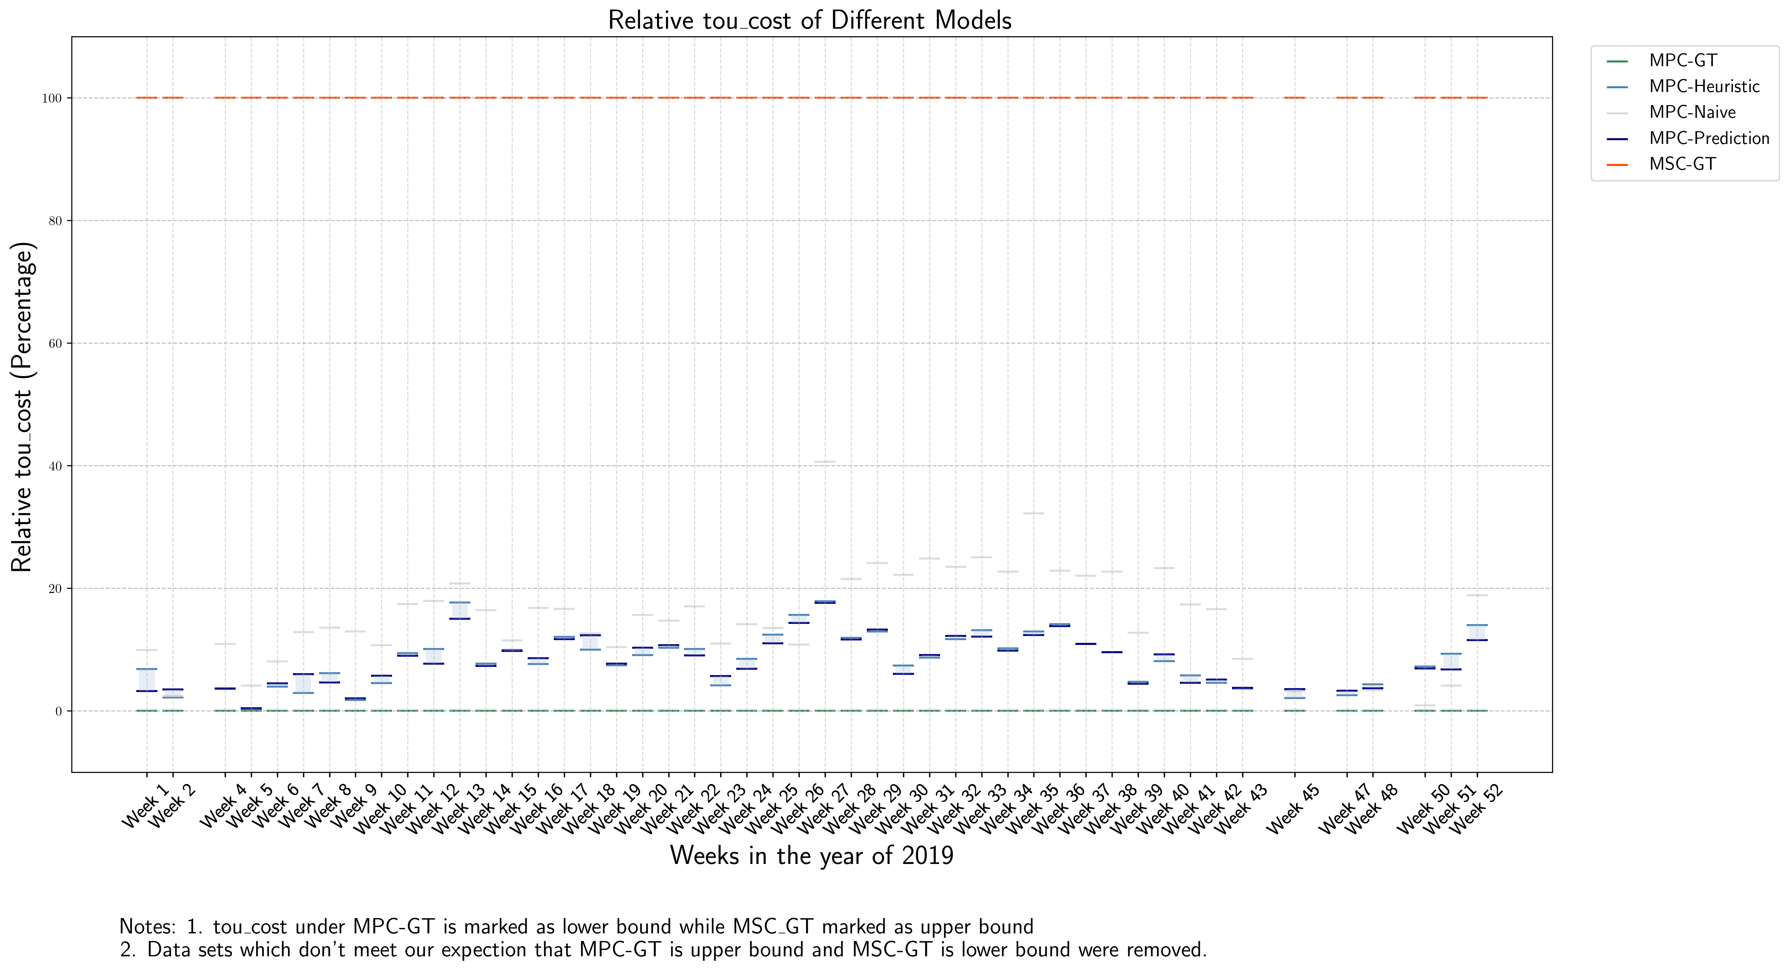
( supplement Visualization of tou_cost )
Base on experiment before

Slide 7
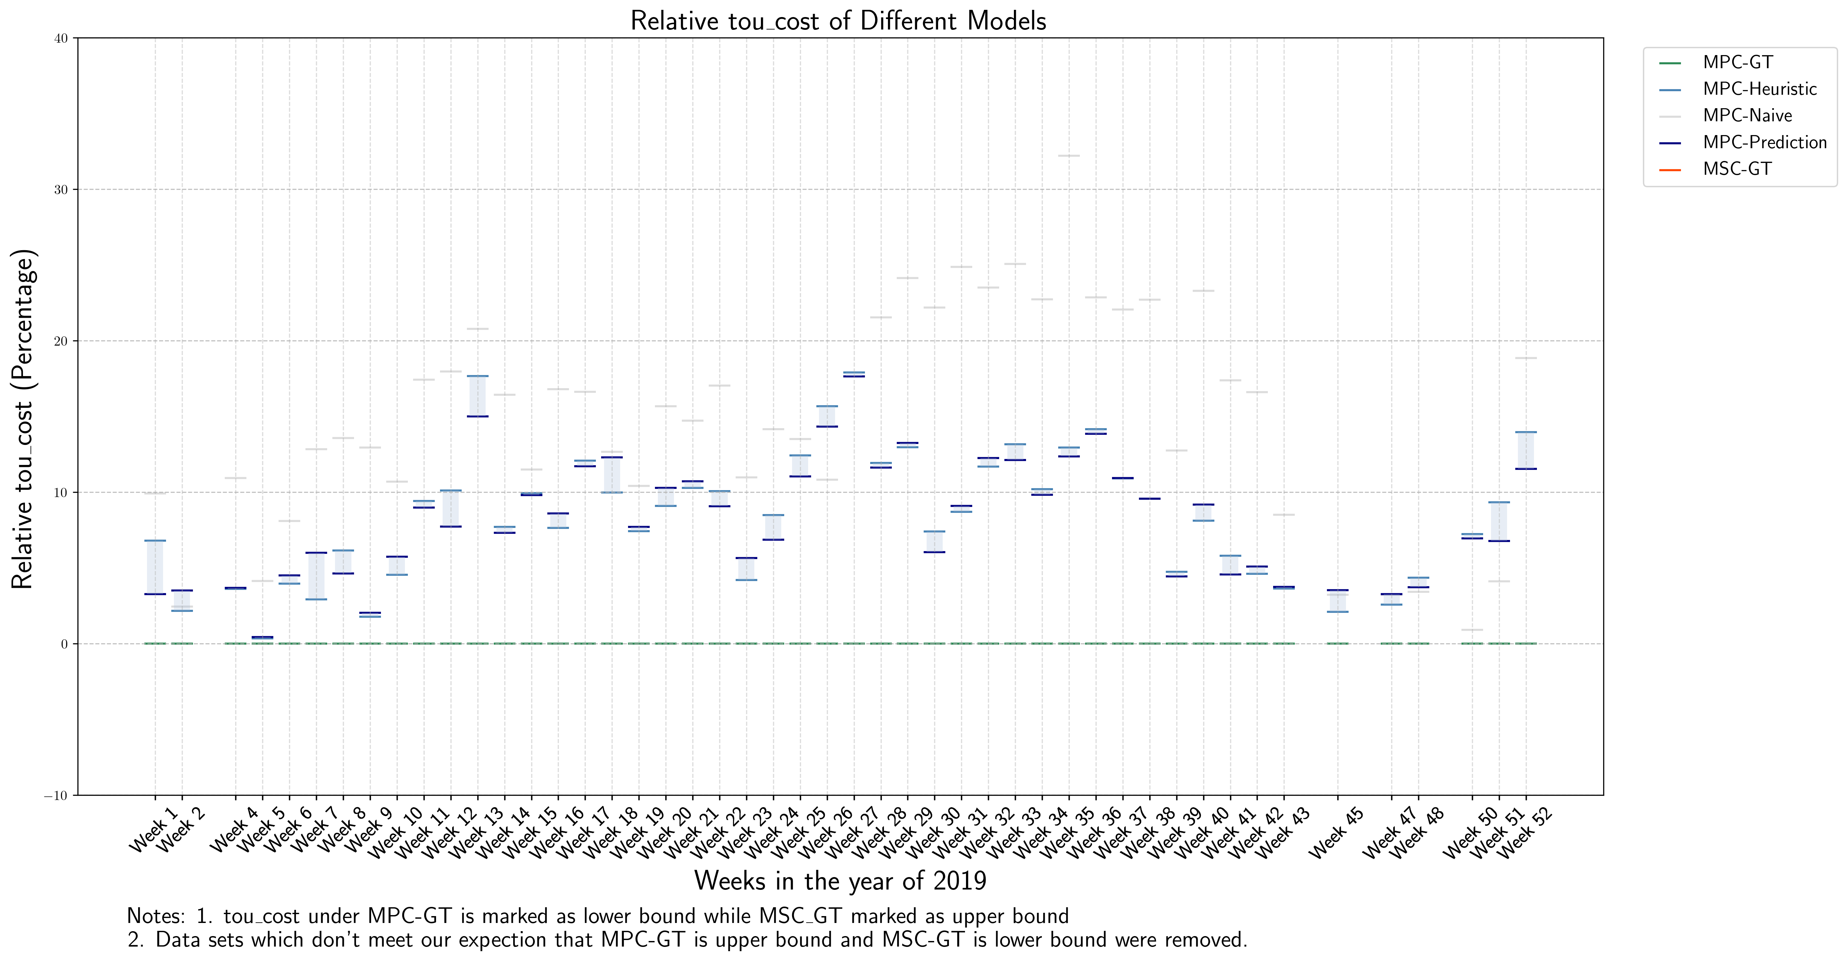
( supplement Visualization of tou_cost )
Base on experiment before

Slide 8
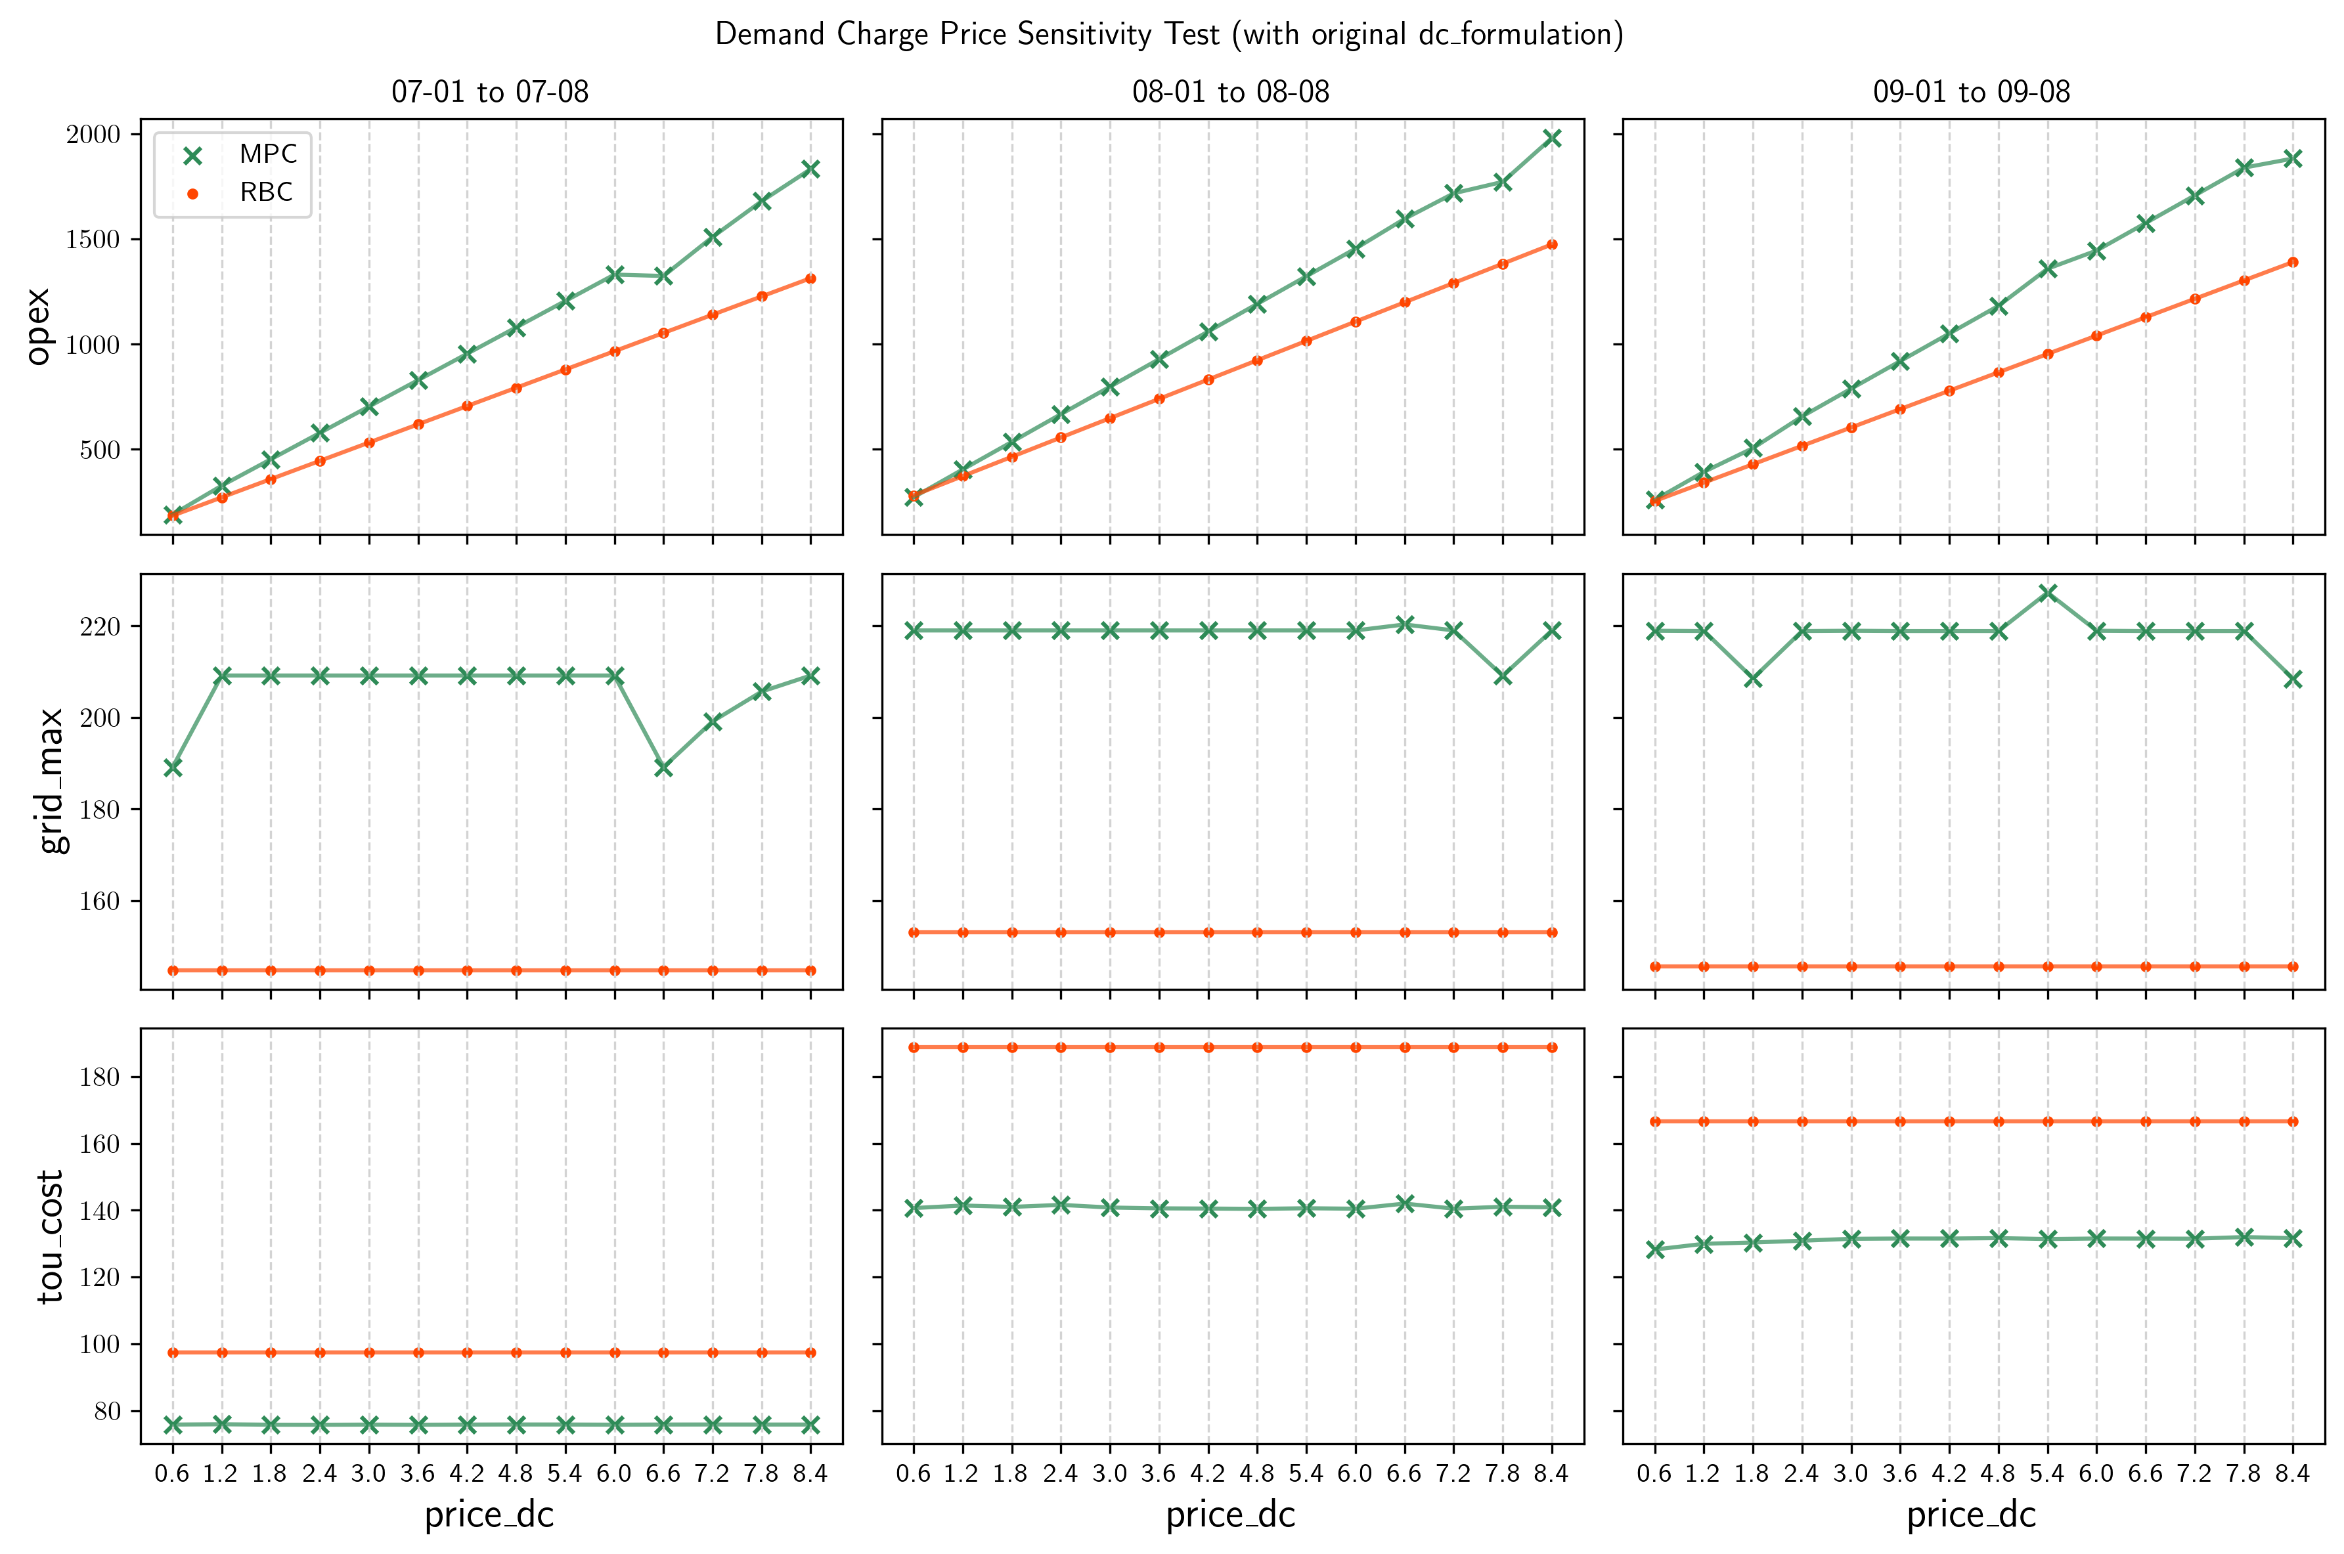
1. How to Formulate Demand Charge
-1.4. “Hyper-param”-dc_price

Slide 9
1. How to Formulate Demand Charge
-1.5 Reformulate by introducing intermediate variables - diagram
Current MPC prediction horizon
P_grid

Slide 10
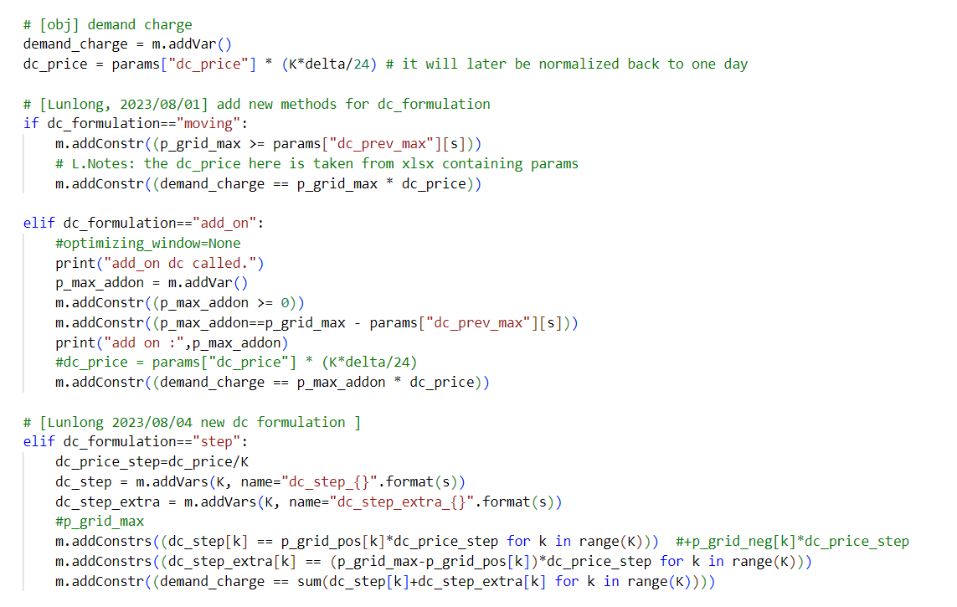
1. How to Formulate Demand Charge
-1.5 Reformulate by introducing intermediate variables - codes

Slide 11
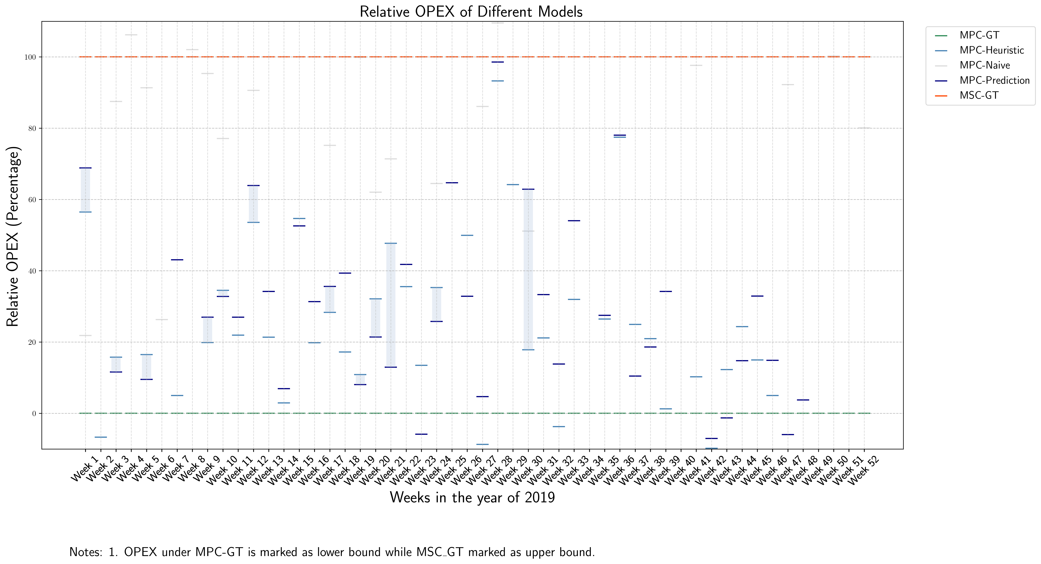
1. How to Formulate Demand Charge
-1.5 Reformulate by introducing intermediate variables - results

Slide 12
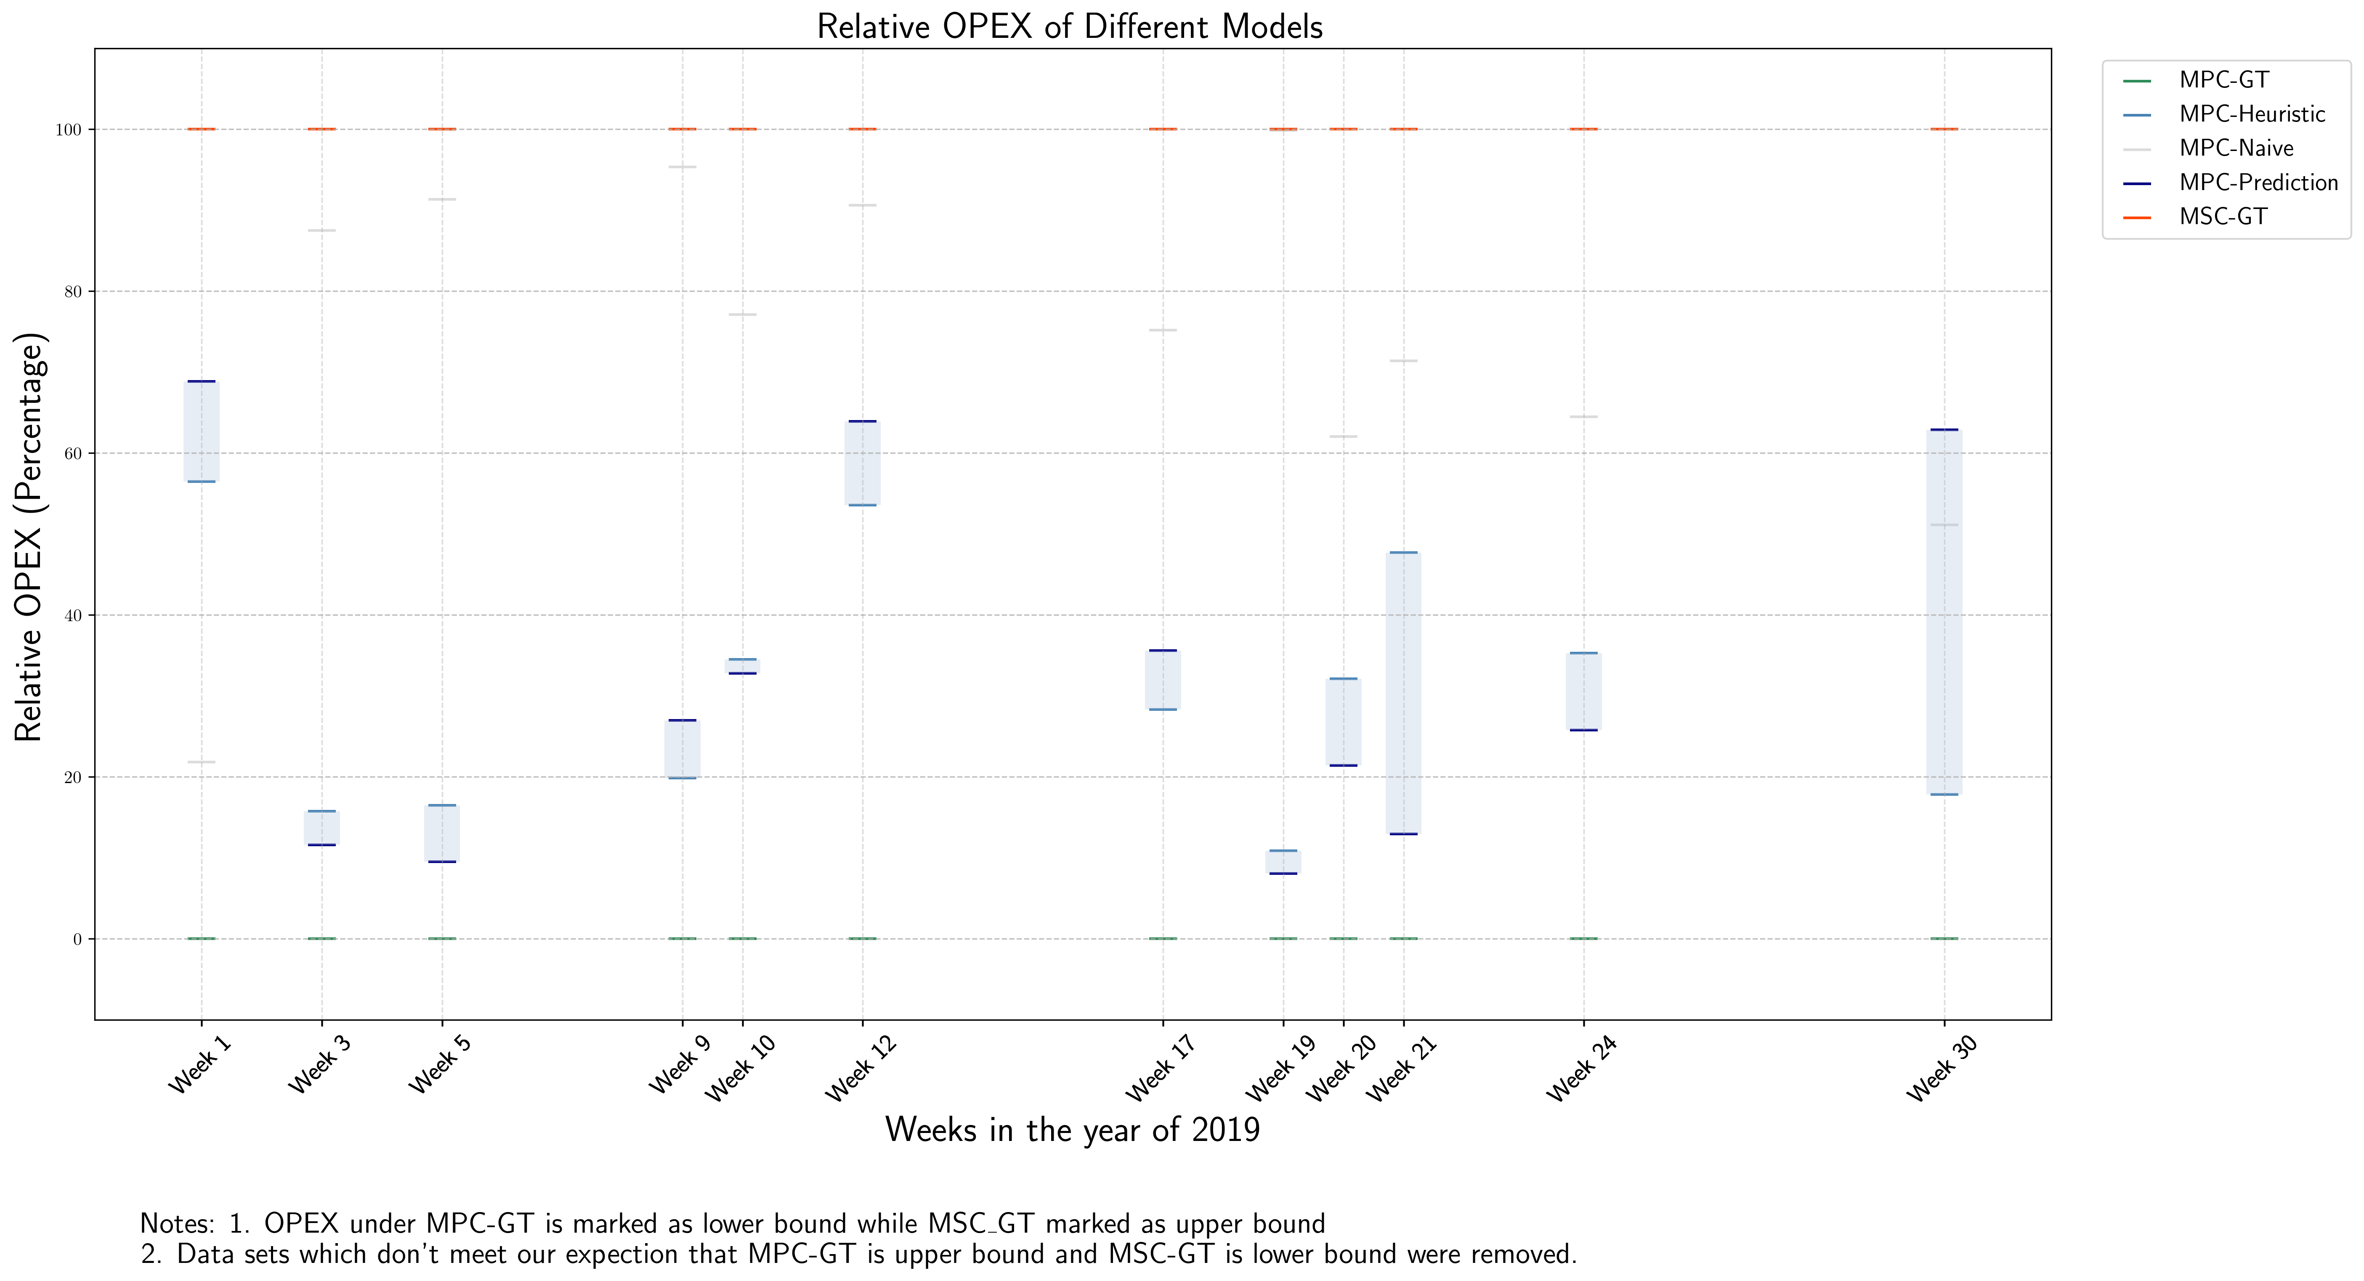
1. How to Formulate Demand Charge
-1.5 Reformulate by introducing intermediate variables - results

Slide 13
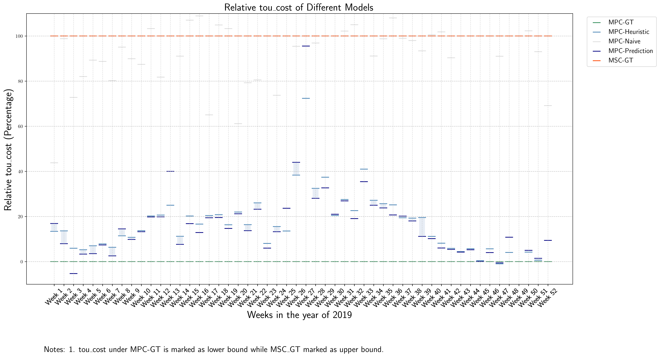
1. How to Formulate Demand Charge
-1.5 Reformulate by introducing intermediate variables - results

Slide 14
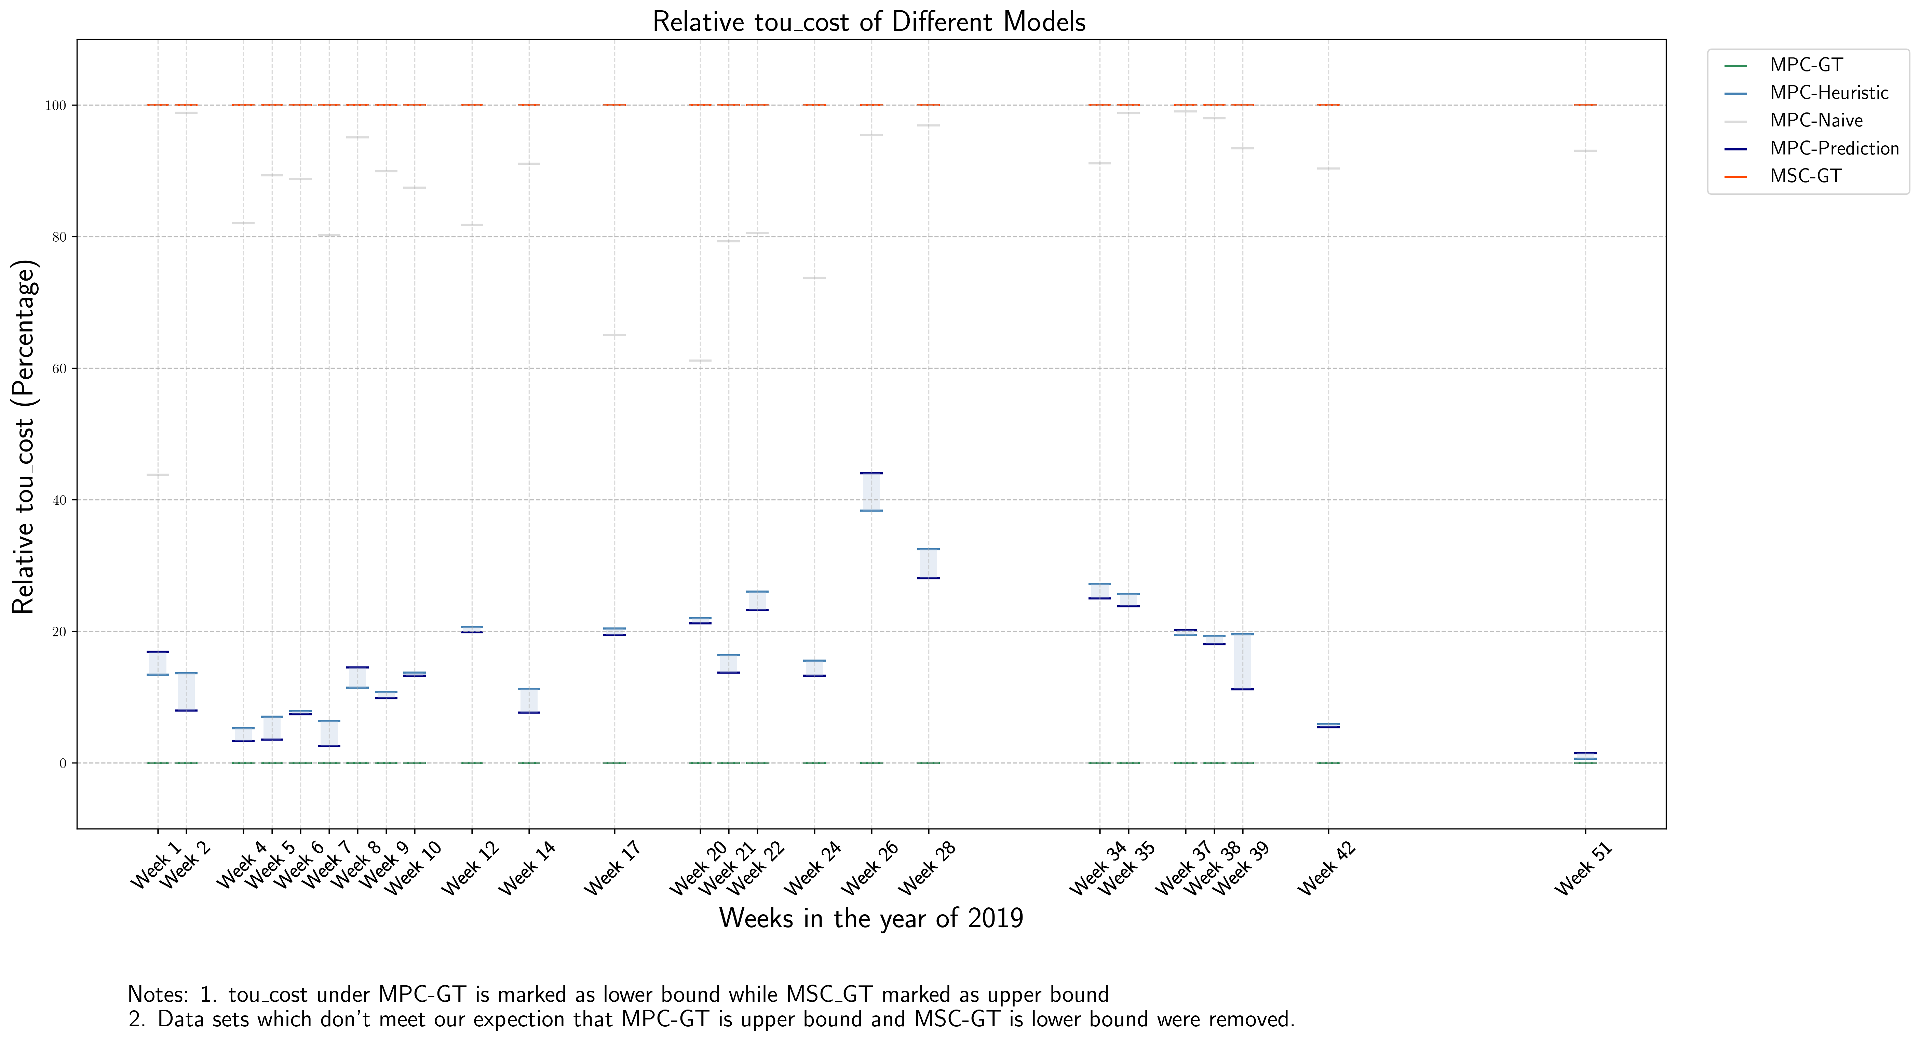
1. How to Formulate Demand Charge
-1.5 Reformulate by introducing intermediate variables - results

Slide 15
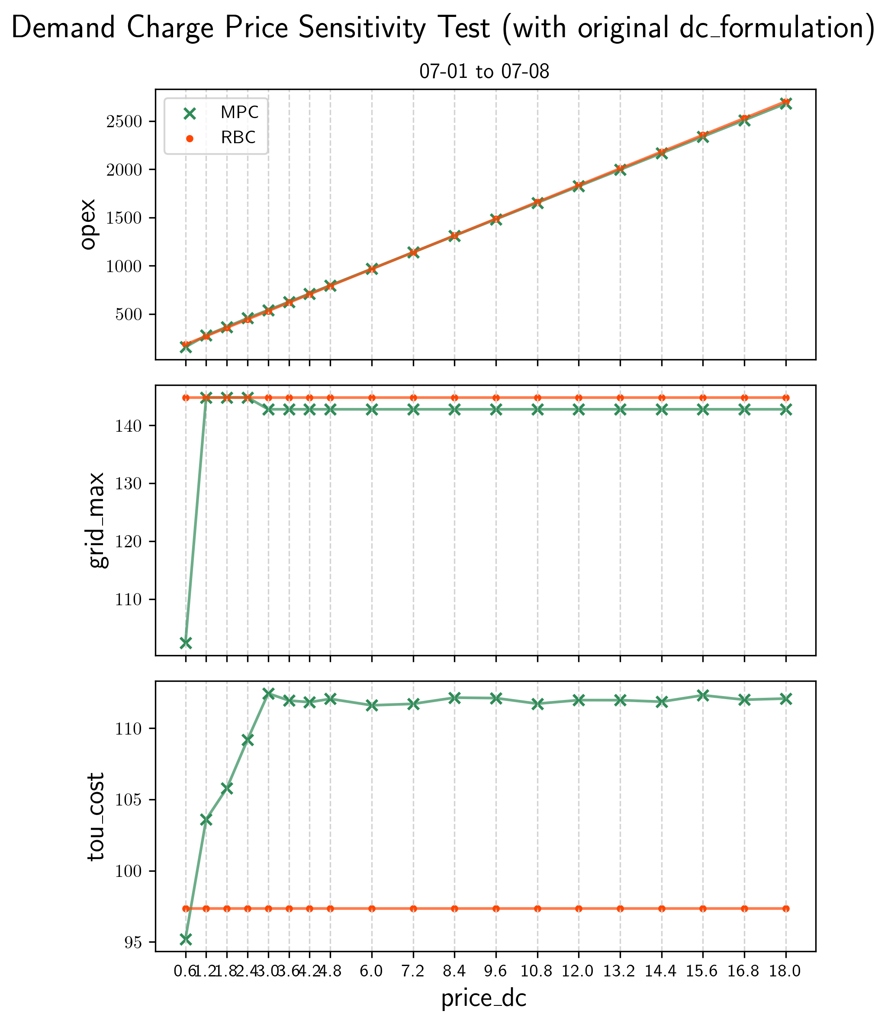
2. Sensitive Tests
-2.1 dc_price

Slide 16
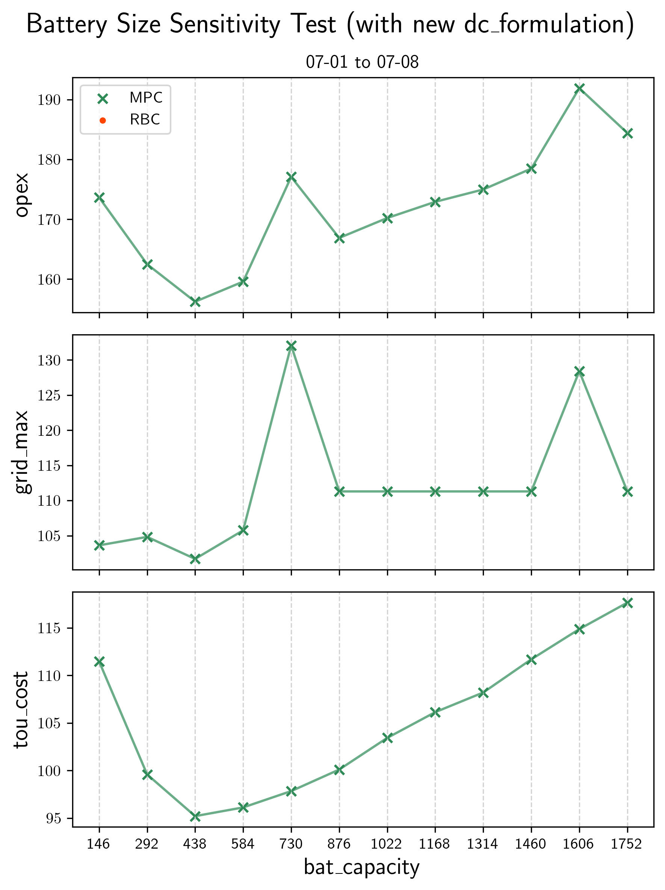
2. Sensitive Tests
-2.2 bat_size

Slide 17
Progress of Week2, August
OUTLINE
Detailed Comparison between MPC_GT and MSC of one day’s opt
Price_DC and MPC_GT Performance
2. Sensitive Tests

Slide 18
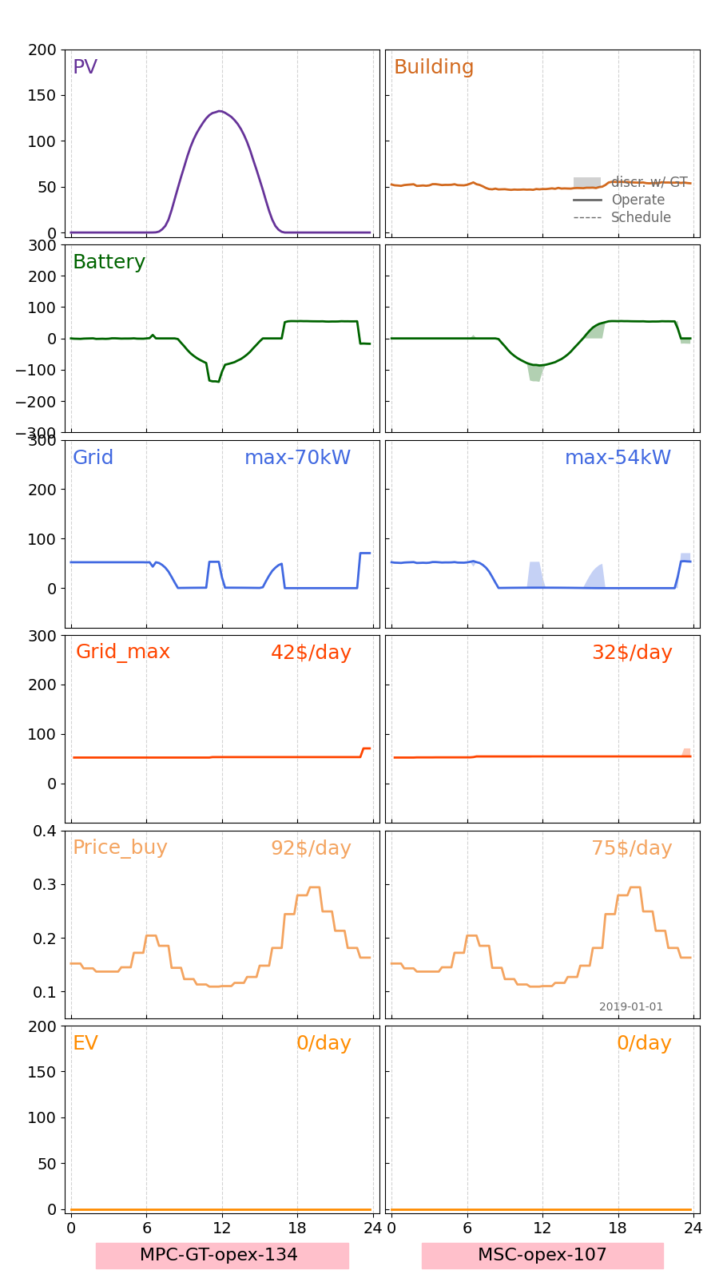
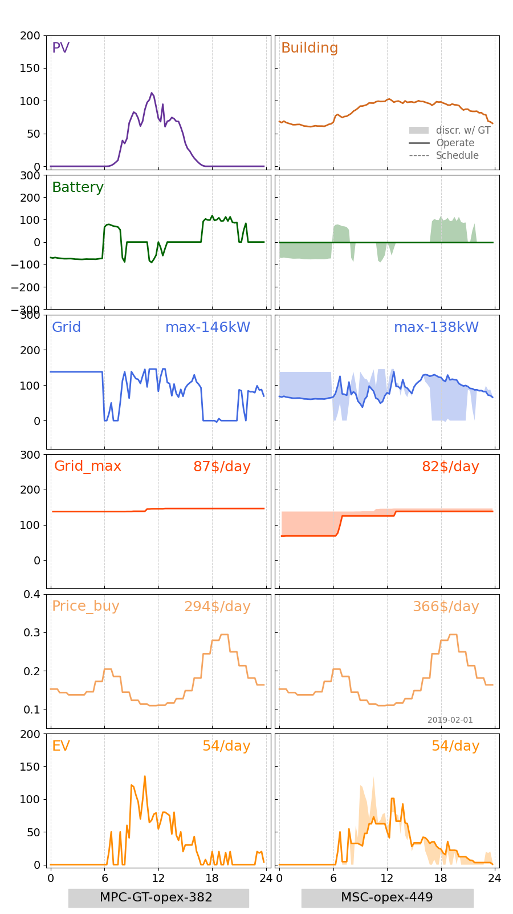
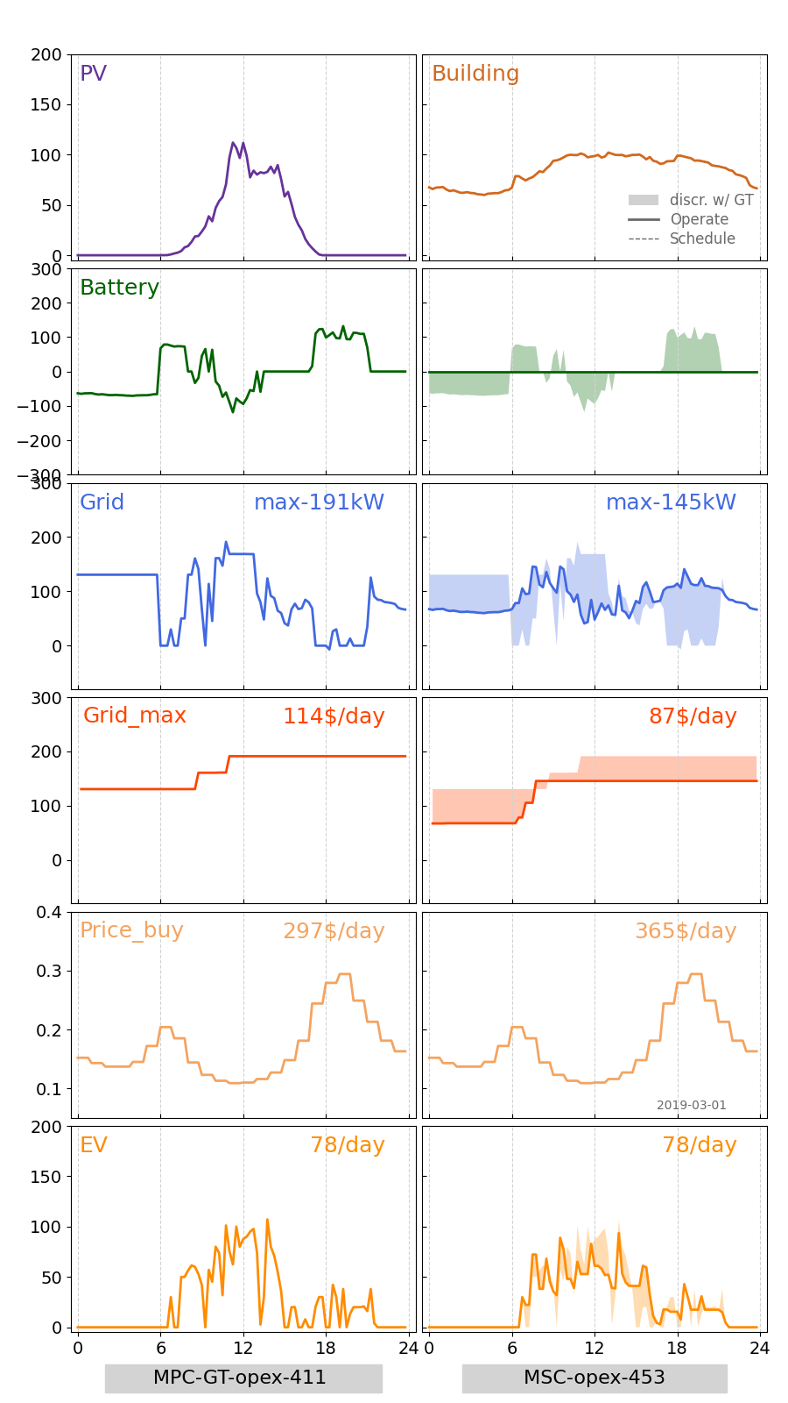
1. Detailed Comparison between MPC_GT and MSC of one day’s opt
-1.1 Jan-Mar
Jan-1
Feb-1
Mar-1

Slide 19
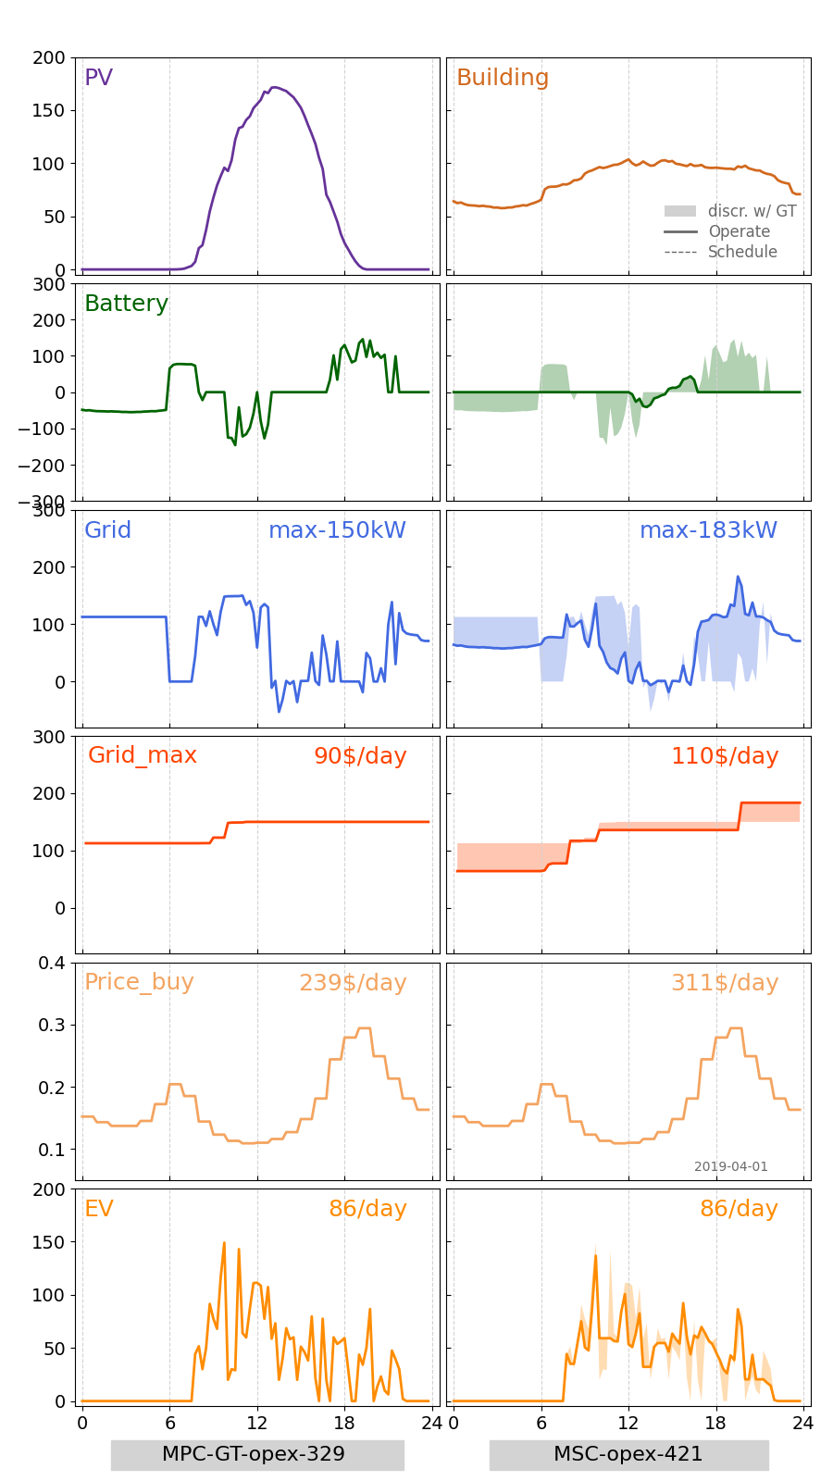
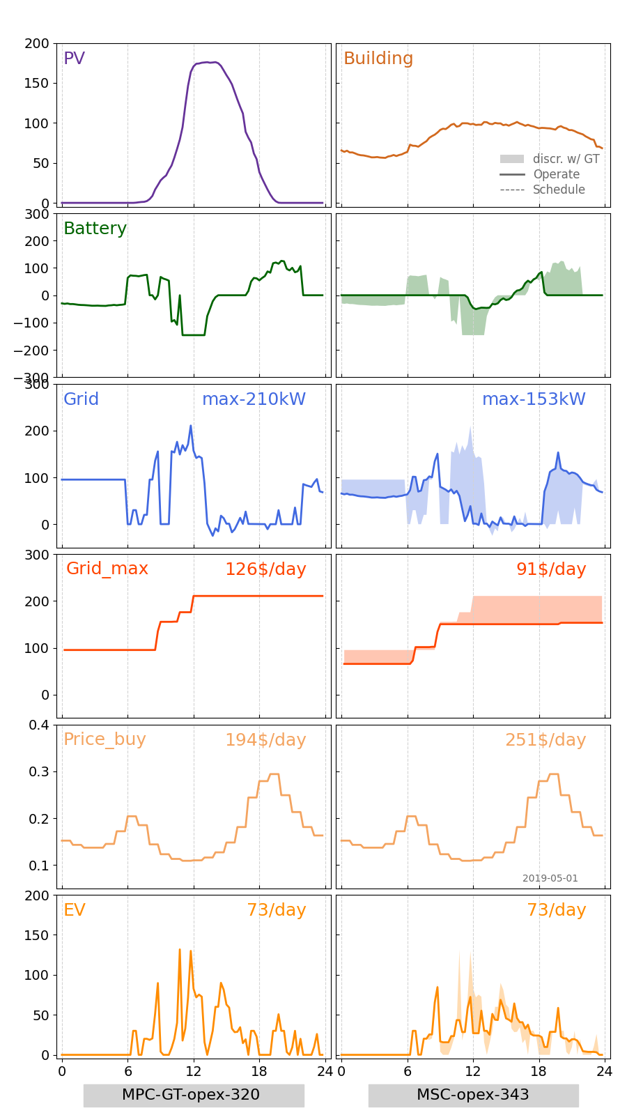
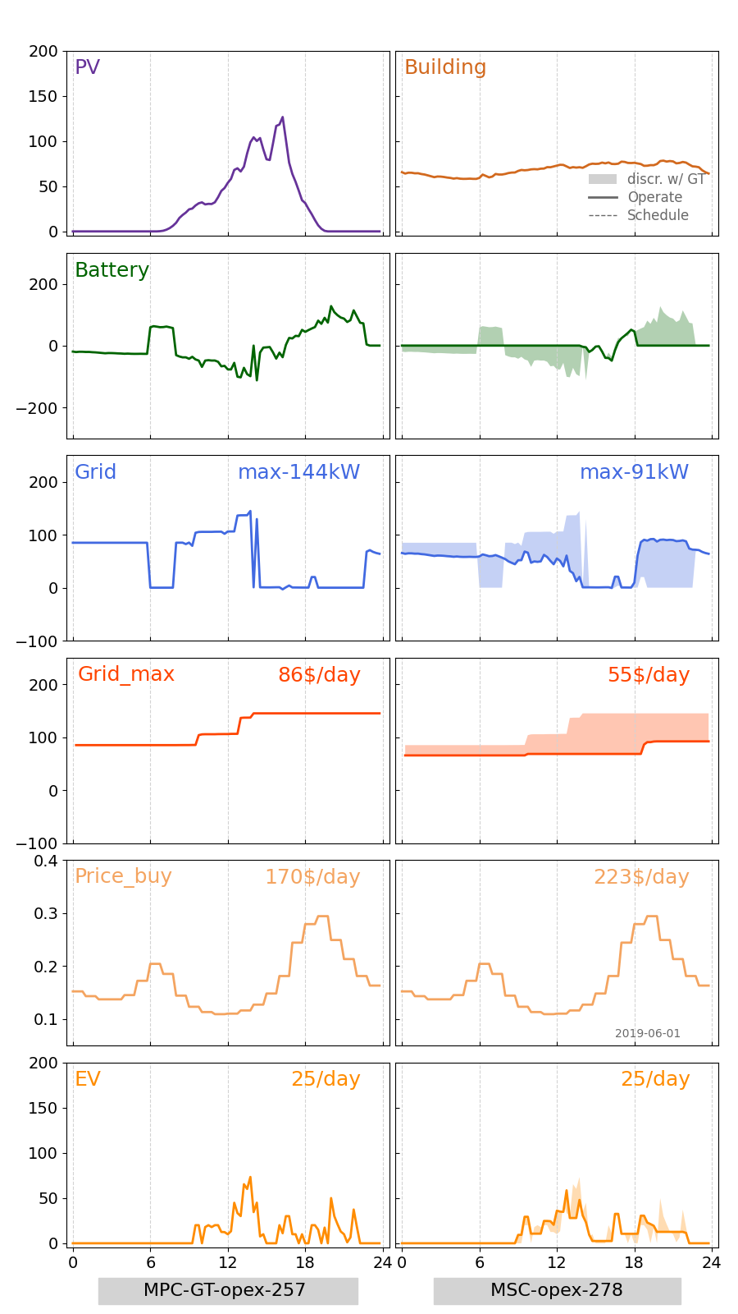
1. Detailed Comparison between MPC_GT and MSC of one day’s opt
-1.2 Jan-Mar
Apr-1
May-1
Jun-1

Slide 20
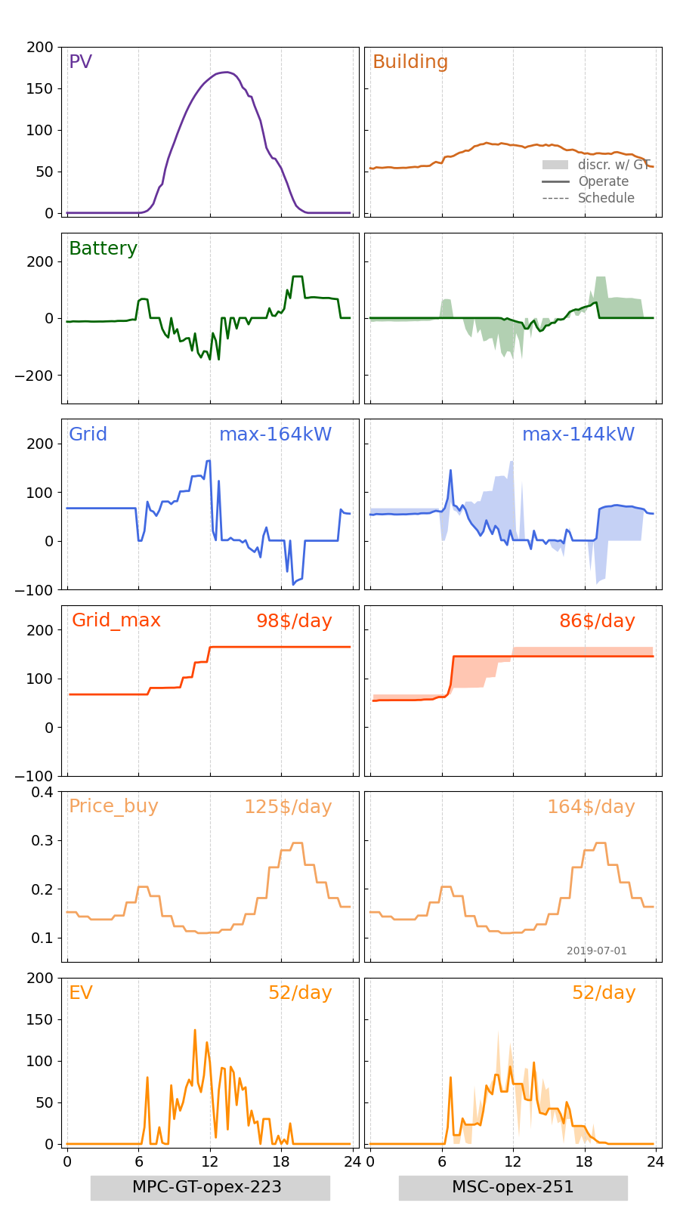
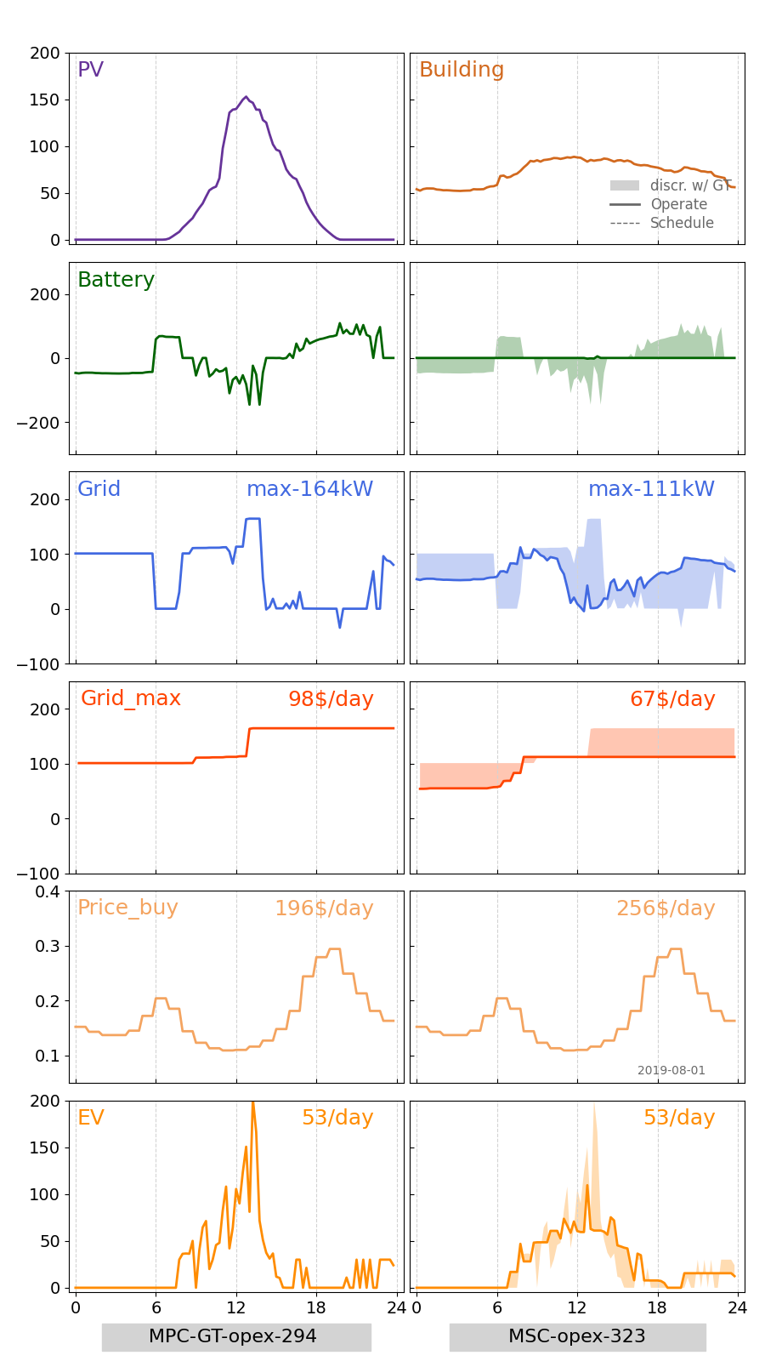
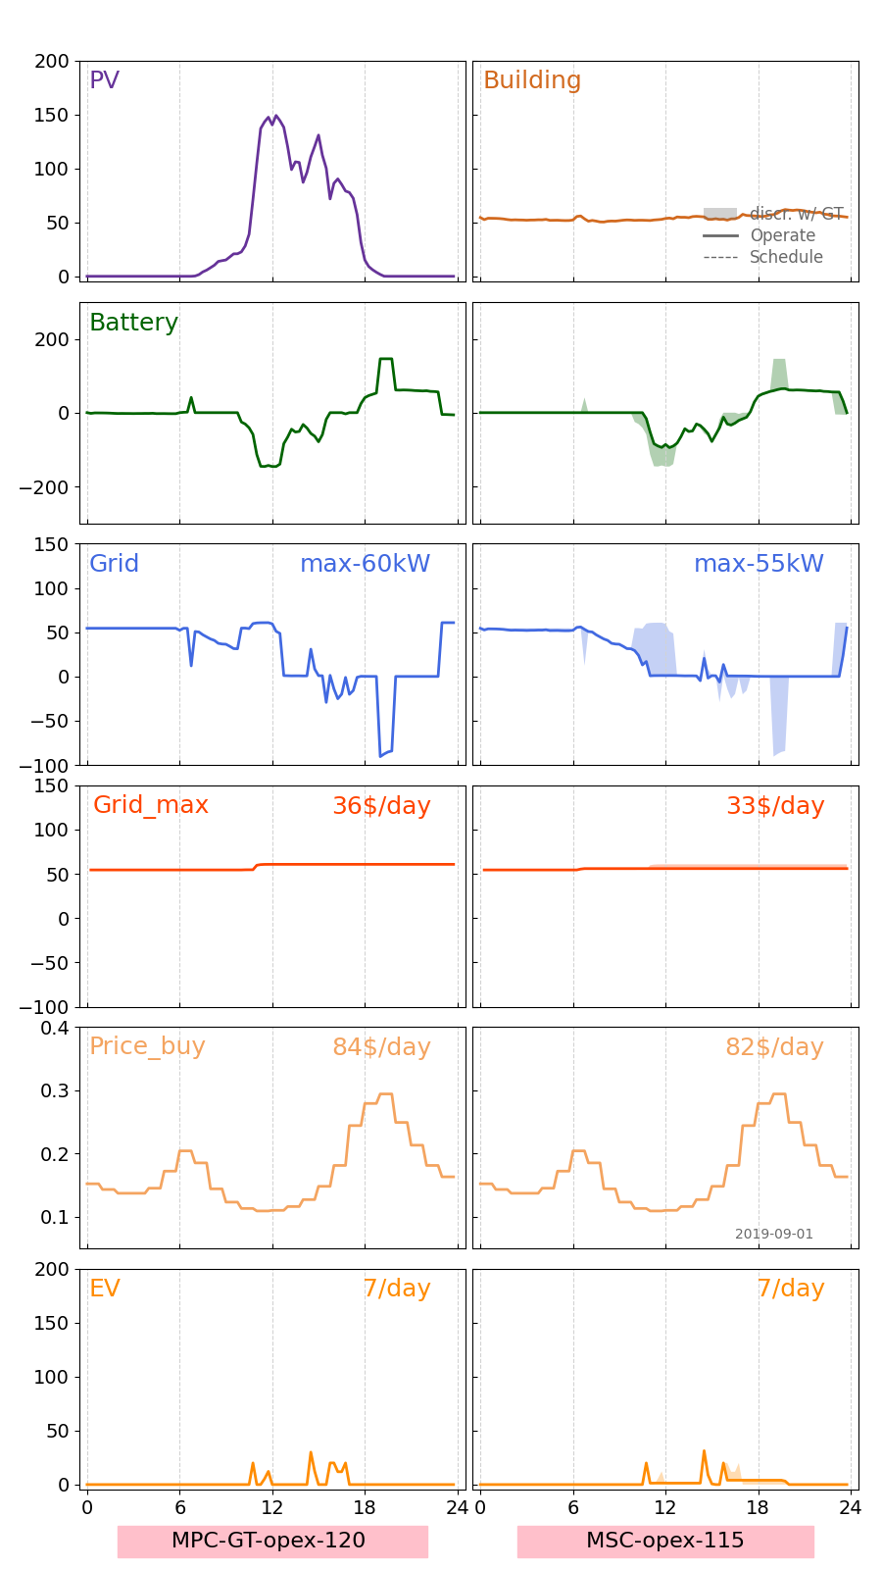
1. Detailed Comparison between MPC_GT and MSC of one day’s opt
-1.3 Jul-Sep
Jul-1
Aug-1
Sep-1

Slide 21
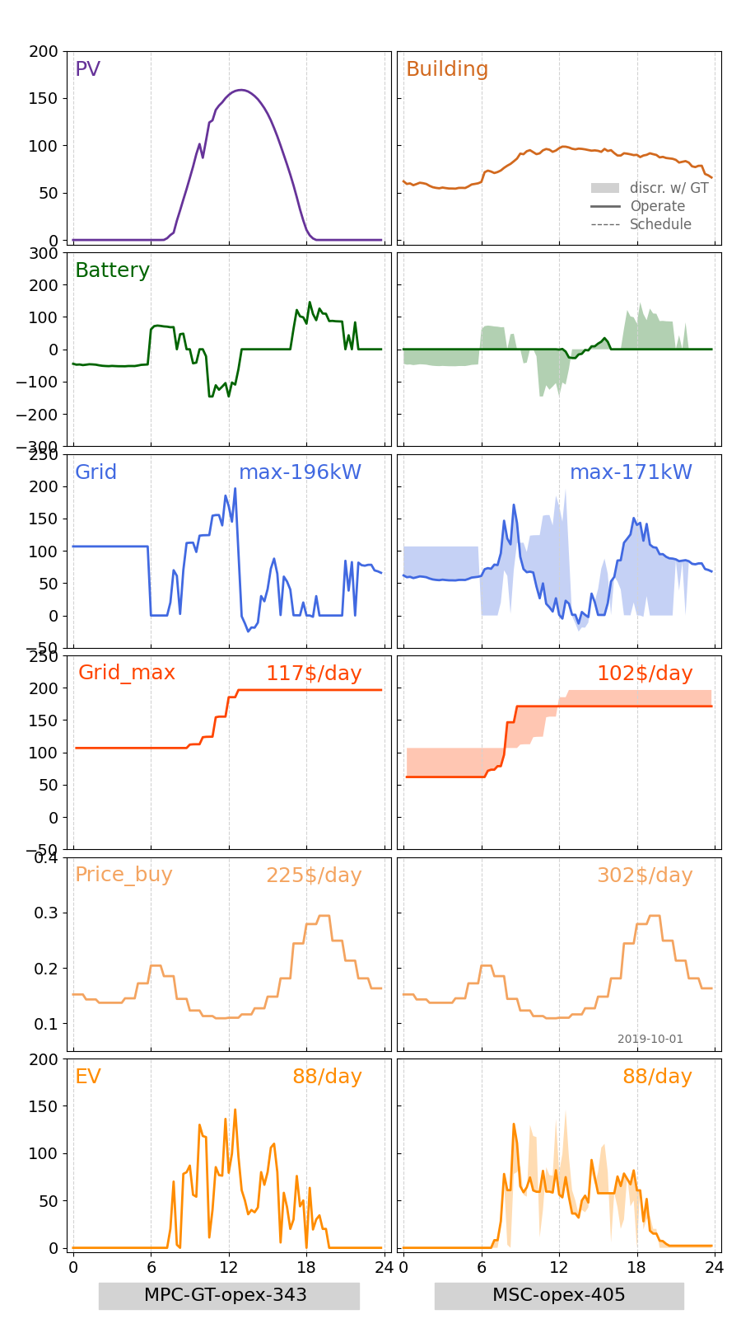
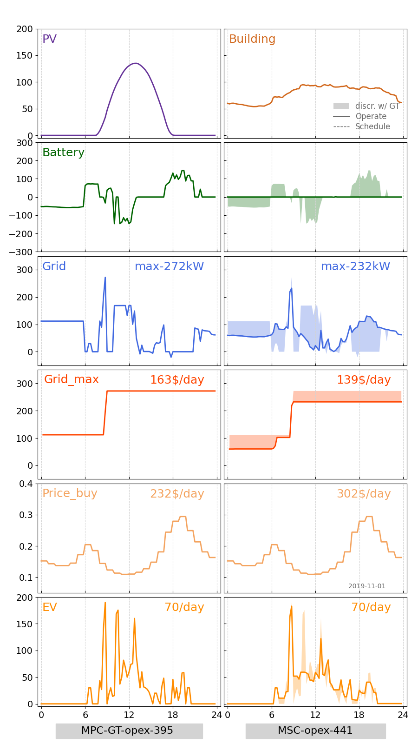
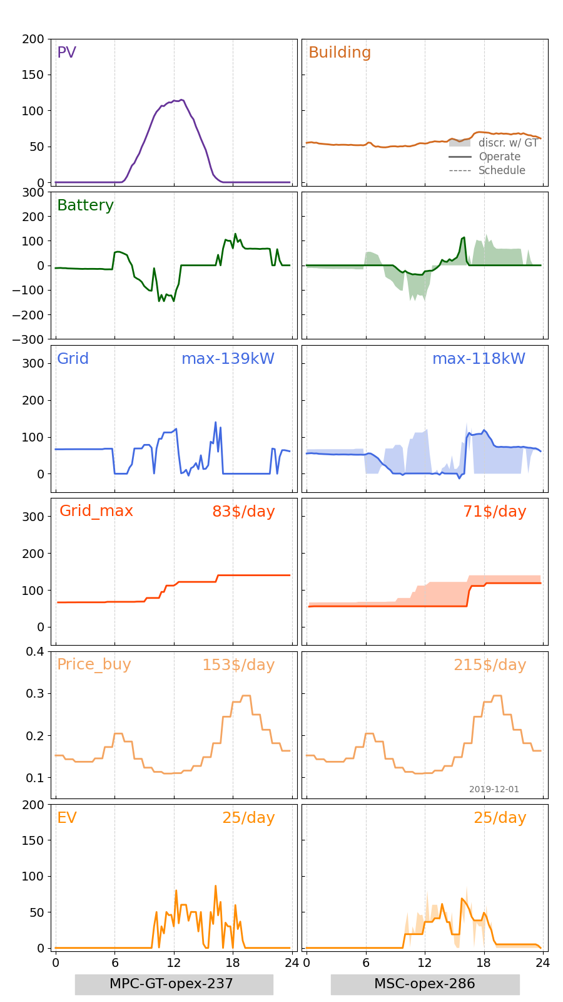
1. Detailed Comparison between MPC_GT and MSC of one day’s opt
-1.4 Oct-Dec
Oct-1
Nov-1
Dec-1

Slide 22
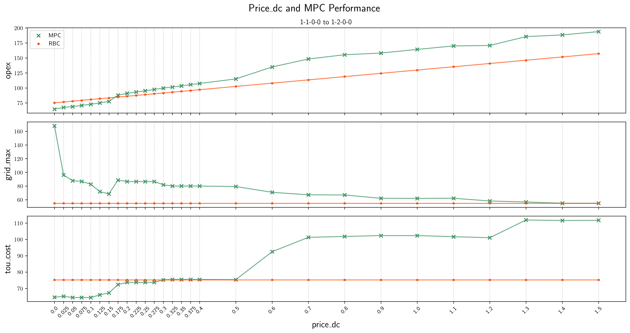
2. Price_DC and MPC_GT Performance
-2.1 Jan-1 EV: 0/day
Oct-1
Nov-1
Dec-1

Slide 23
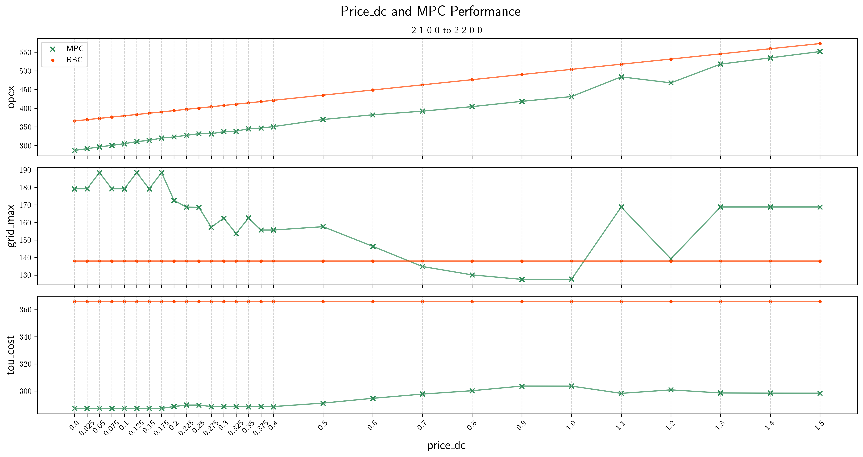
2. Price_DC and MPC_GT Performance
-2.2 Feb-1 EV: 54/day
Oct-1
Nov-1
Dec-1

Slide 24
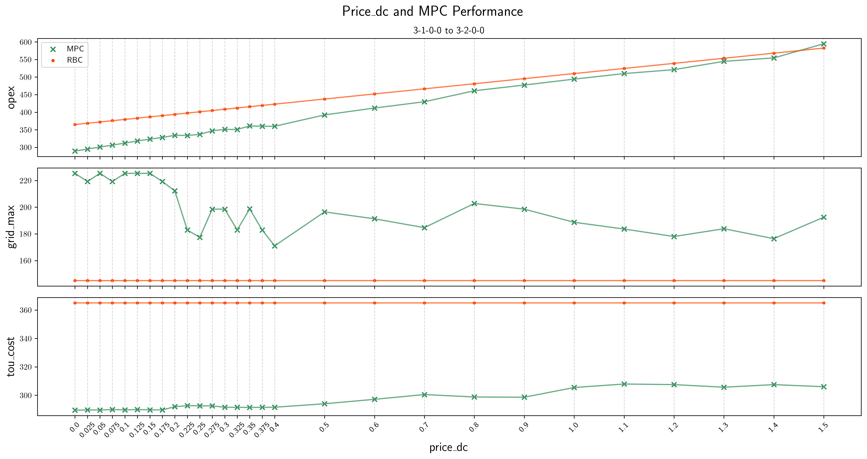
2. Price_DC and MPC_GT Performance
-2.3 Mar-1 EV: 78/day
Oct-1
Nov-1
Dec-1

Slide 25
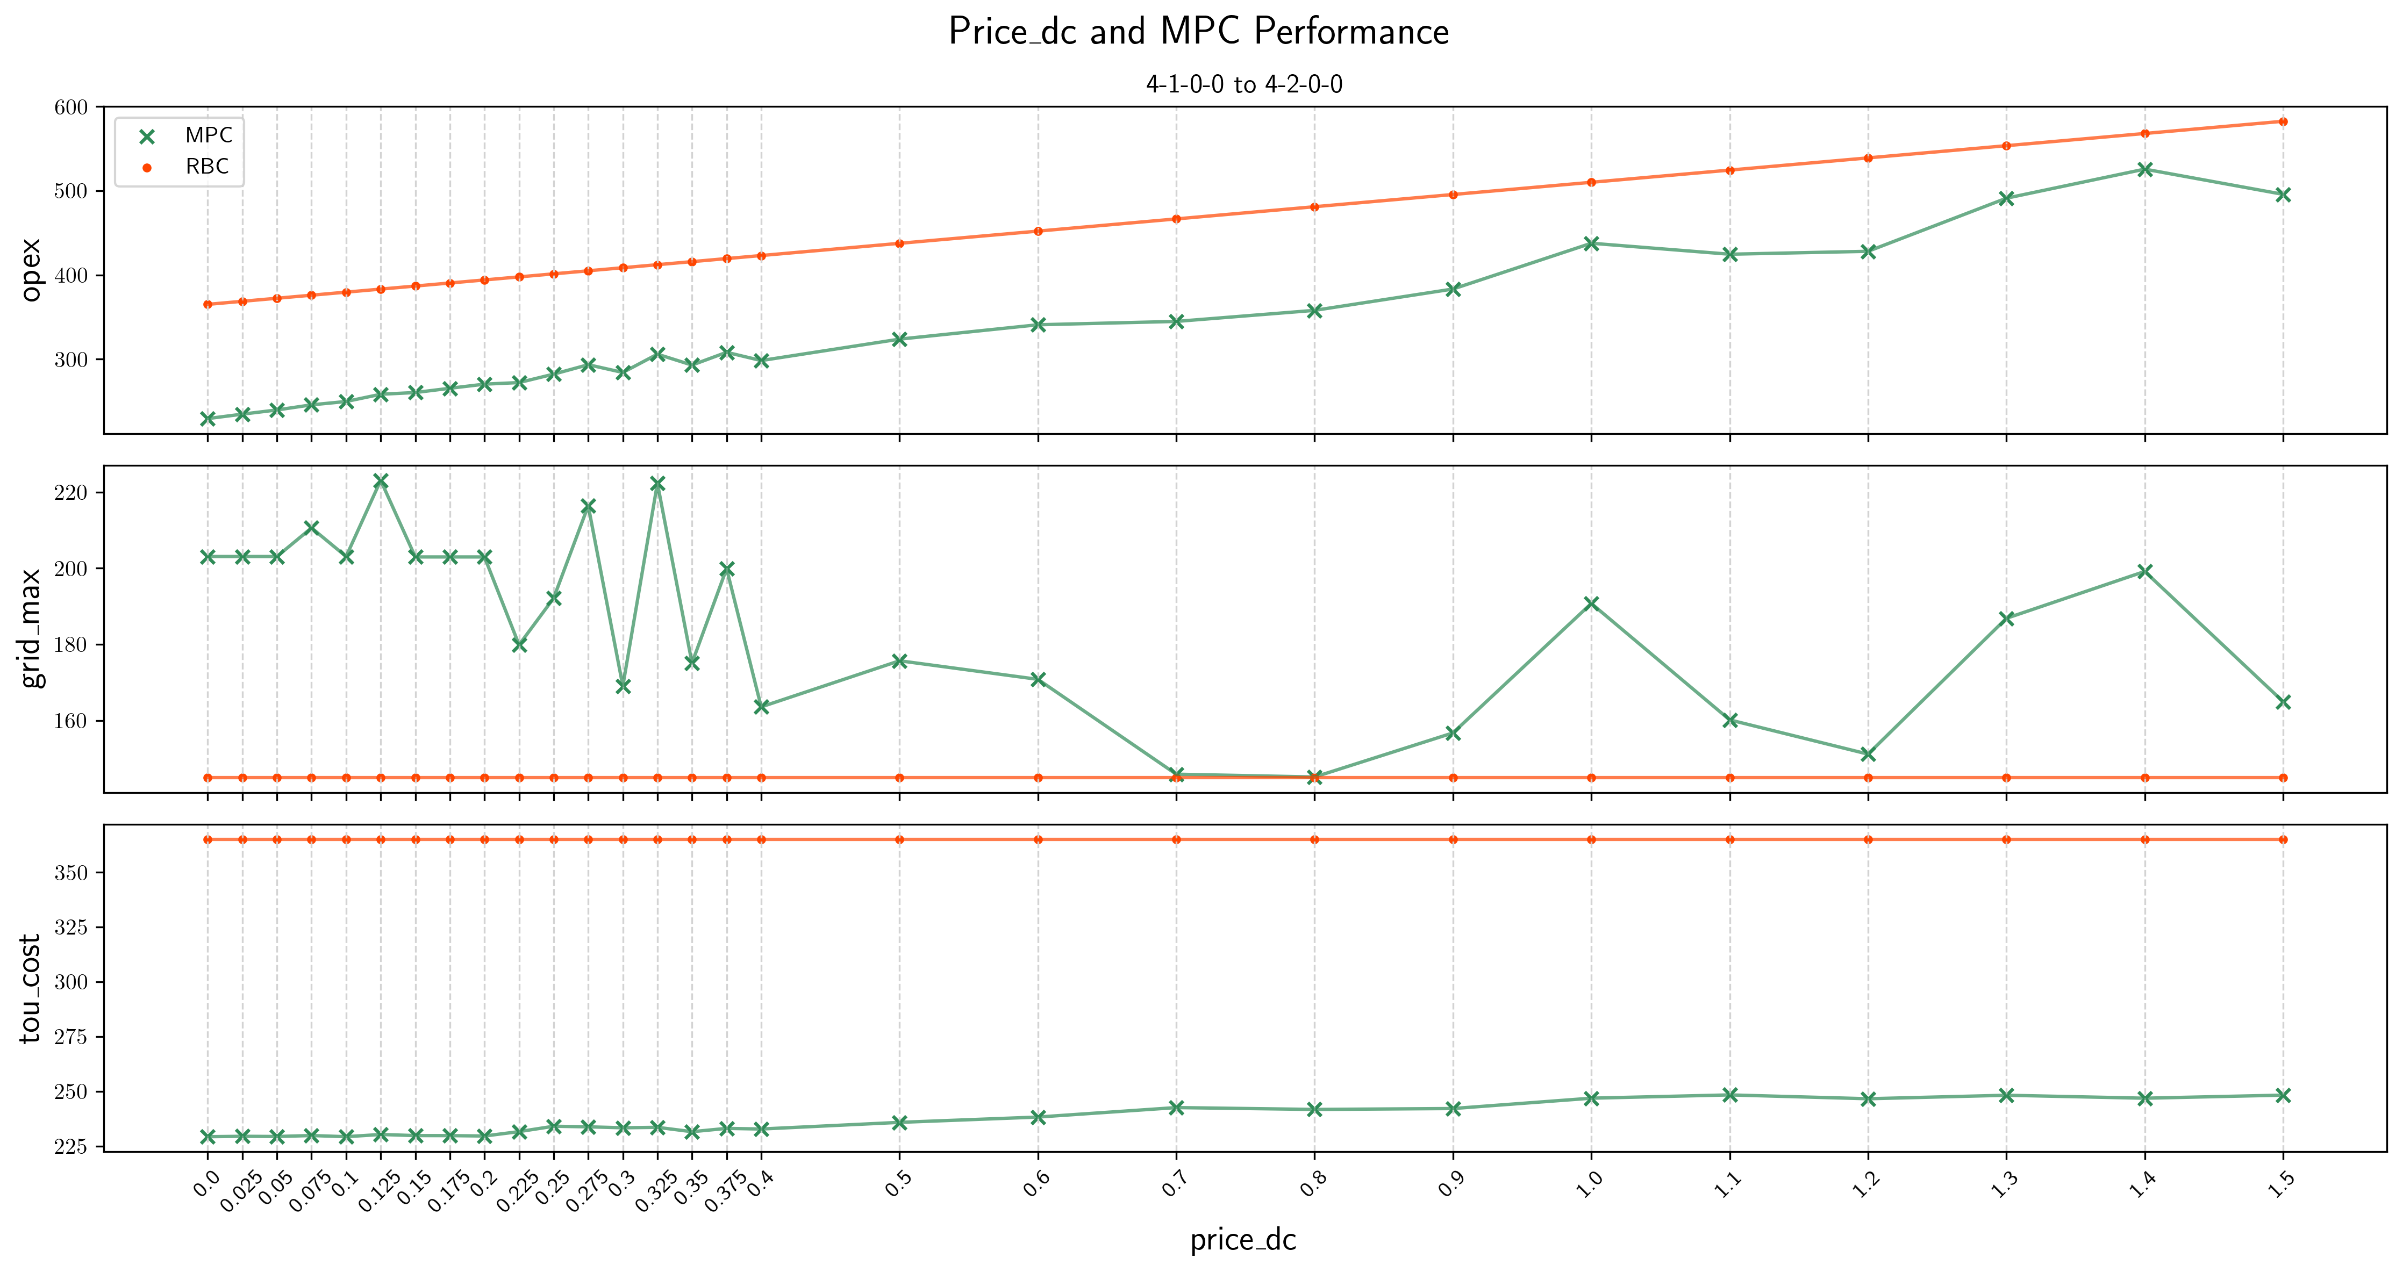
2. Price_DC and MPC_GT Performance
-2.4 Apr-1 EV: 86/day
Oct-1
Nov-1
Dec-1

Slide 26
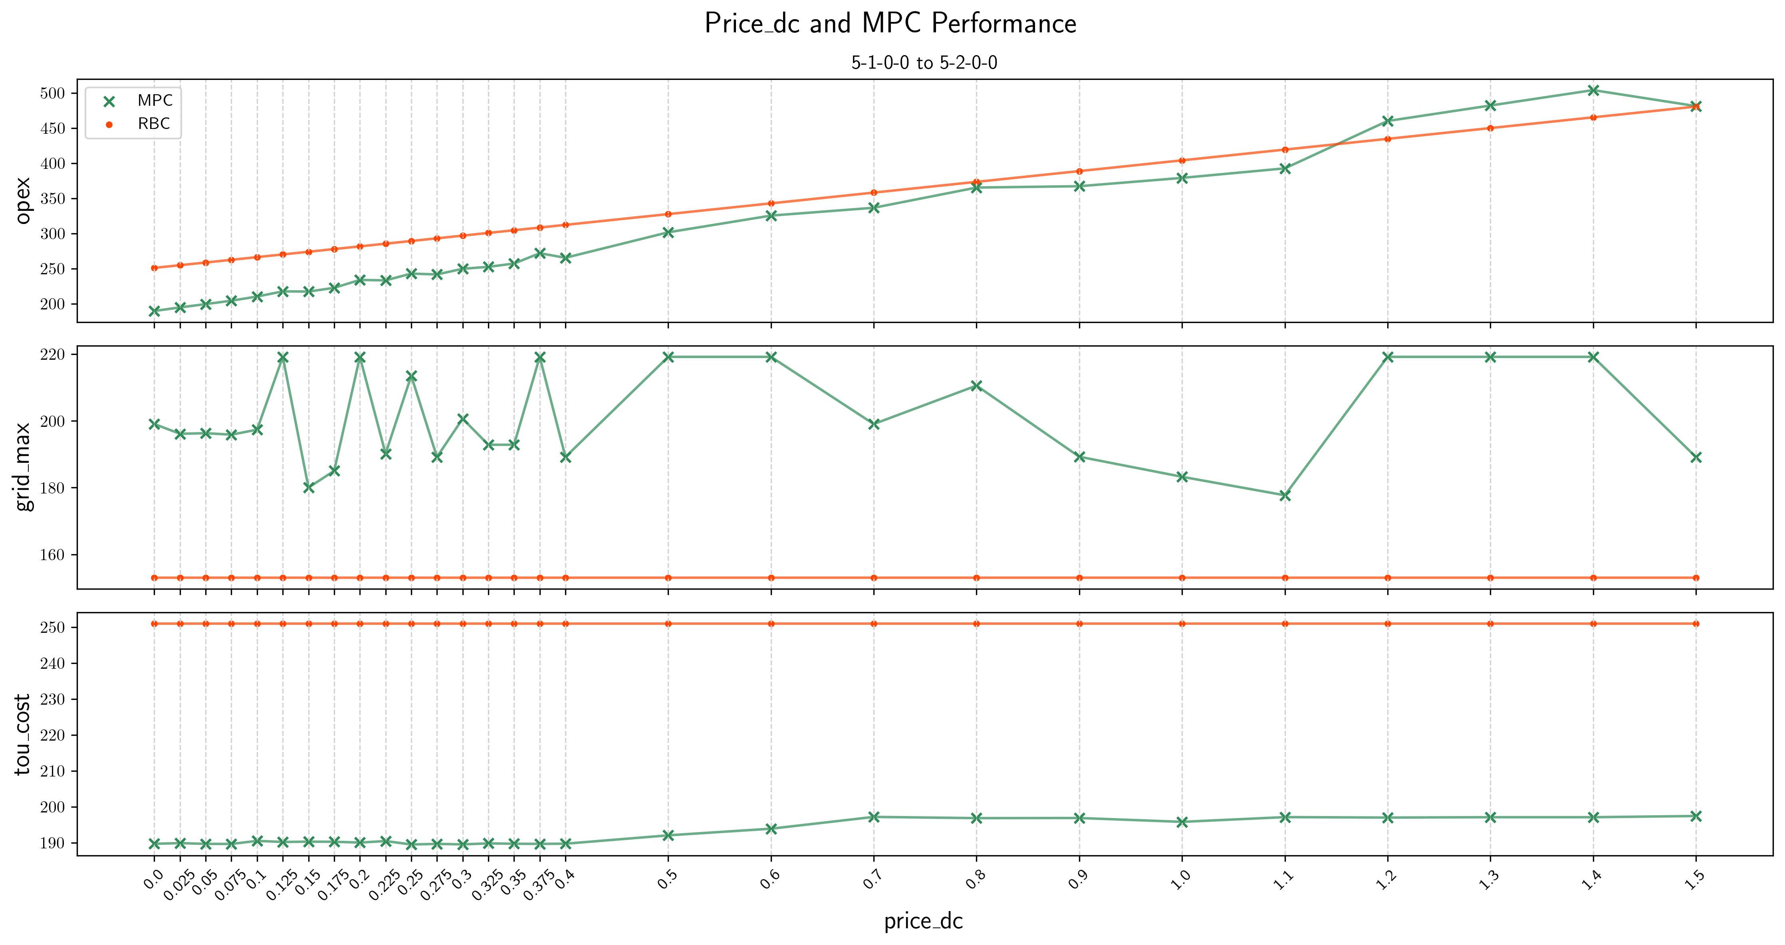
2. Price_DC and MPC_GT Performance
-2.5 May-1 EV: 73/day
Oct-1
Nov-1
Dec-1

Slide 27

2. Price_DC and MPC_GT Performance
-2.6 Jun-1 EV: 25/day
Oct-1
Nov-1
Dec-1

Slide 28
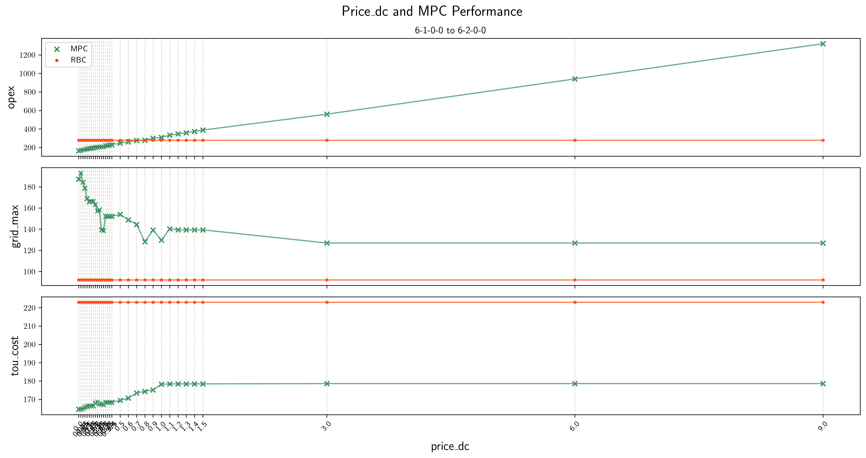
2. Price_DC and MPC_GT Performance
-2.6 Jun-1-large scale
Oct-1
Nov-1
Dec-1

